Slide 1

our Core Values Experiential Here’s a fun and self reflective exercise that you’ll be a part of this Karibu ceremony. Let’s take a sneak peek to see what we’re getting into.

Slide 2
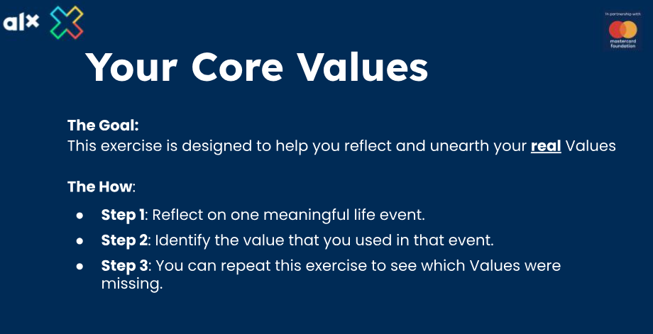

Slide 3
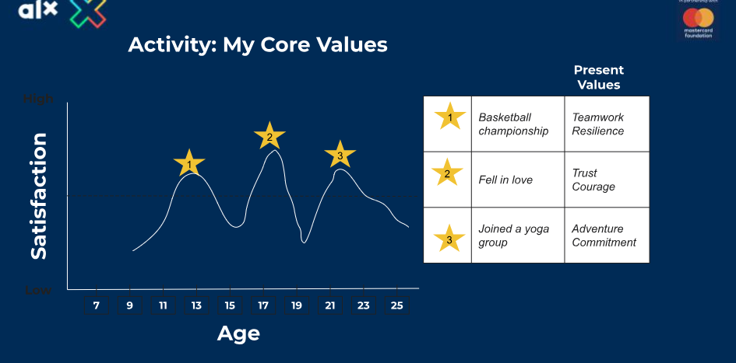

Slide 4
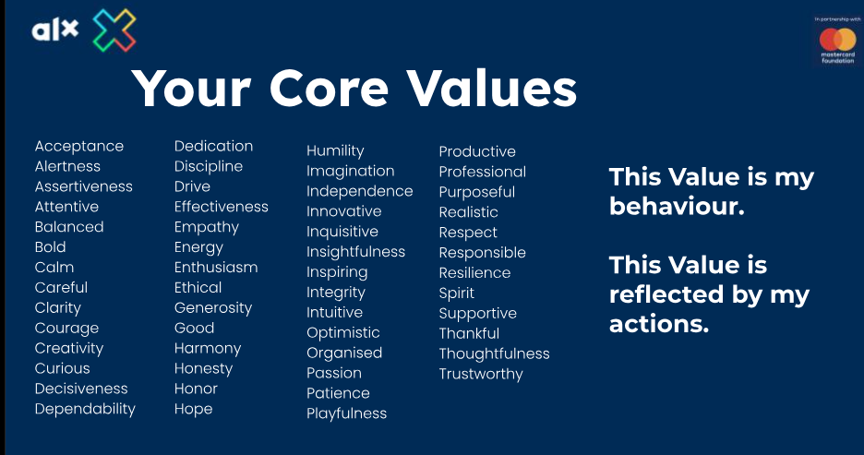

Slide 5


Slide 6
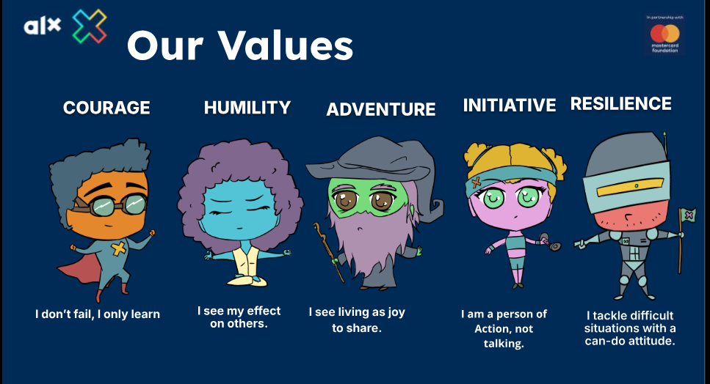

Slide 7
